Slide 1
Chapter 1
Differing Perspectives on Quality

Slide 2
Differing Perspectives on Quality
Chapter 1
What is Quality?
Differing Functional Perspectives on Quality
The Three Spheres of Quality
Other Perspectives on Quality
Arriving at a Common Perspective
(

Slide 3
5 Approaches to Defining Quality – Garvin
The Transcendent Approach: a quality cannot be defined precisely, we learn to recognize it only through experience
Innate excellence

Slide 4
5 Approaches to Defining Quality – Garvin
The Product-based Approach: quality is precise and measurable variable, products can be ranked – quality products have more attributes (computer with more memory)

Slide 5
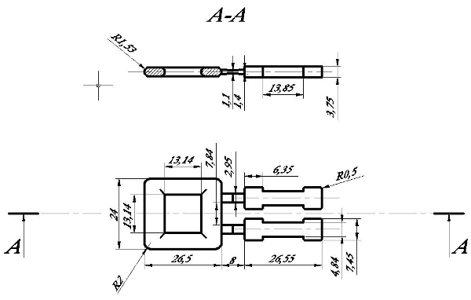
5 Approaches to Defining Quality - Garvin
The Manufacturing-based Approach : products or services meet stated requirements,
Manufacturing and engineering practise - Quality is measured by the manufacturer’s ability to target the requirements consistently with little variability

Slide 6
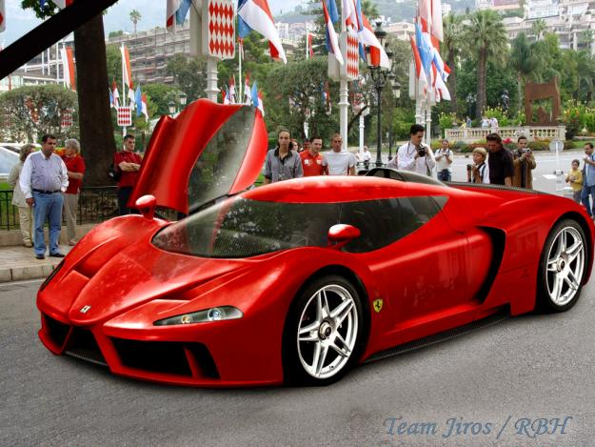
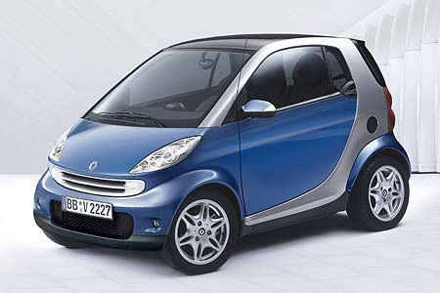
5 Approaches to Defining Quality - Garvin 4
The User-based Approach : quality of a product is determined by the consumer. There are widely varying individual preferences.

Slide 7
5 Approaches to Defining Quality - Garvin 5
The Value-based Approach : quality is defined in costs and prices. How much is the benefit of the good or service outweigh the cost?
Did the costumer get his or her money’s worth?

Slide 8
What is Quality? Garvin’s Product Quality Dimensions
Performance Features Reliability Conformance | Durability Serviceability Aesthetics Perceived Quality
©

Slide 9
What is Quality? Garvin’s Product Quality Dimensions
(
Performance Feature Reliability Conformance | Efficiency with which a product achieves its intended purpose

Slide 10
What is Quality Garvin’s Product Quality Dimensions
Performance Features Reliability Conformance | Attributes that supplement the product’s basic performance

Slide 11
What is Quality Garvin’s Product Quality Dimensions
Performance Features Reliability Conformance | Product’s propensity to perform consistently over the product’s useful life.

Slide 12
What is Quality Garvin’s Product Quality Dimensions
Performance Features Reliability Conformance | Adherence to quantifiable specifications

Slide 13
What is Quality Garvin’s Product Quality Dimensions
Ability to tolerate stress or trauma without failing | Durability Serviceability Aesthetics Perceived Quality

Slide 14
What is Quality Garvin’s Product Quality Dimensions
The ease and low cost of repair for a product | Durability Serviceability Aesthetics Perceived Quality

Slide 15
What is Quality Garvin’s Product Quality Dimensions
Degree to which product attributes are matched to consumer preferences | Durability Serviceability Aesthetics Perceived Quality

Slide 16
What is Quality Garvin’s Product Quality Dimensions
Quality as the customer perceives it…image, recognition, word of mouth. | Durability Serviceability Aesthetics Perceived Quality

Slide 17
HIPI principles
Heterogenity
Intangibility
Perishability
Inseparability

Slide 18
What is Quality PZ&B’s Service Quality Dimensions
Tangibles Service Reliability Responsiveness Assurance Empathy

Slide 19
What is Quality PZ&B’s Service Quality Dimensions
Tangibles Service Reliability Responsiveness Assurance Empathy | Physical appearance of the facility, equipment, personnel and communications materials

Slide 20
What is Quality PZ&B’s Service Quality Dimensions
Tangibles Service Reliability Responsiveness Assurance Empathy | The ability of the service provider to perform the promised service dependably and accurately

Slide 21
What is Quality PZ&B’s Service Quality Dimensions
Tangibles Service Reliability Responsiveness Assurance Empathy | The willingness of the provider to be helpful and prompt in providing service

Slide 22
What is Quality PZ&B’s Service Quality Dimensions
Tangibles Service Reliability Responsiveness Assurance Empathy | The knowledge and courtesy of the employees and their ability to inspire trust and confidence

Slide 23
What is Quality PZ&B’s Service Quality Dimensions
Tangibles Service Reliability Responsiveness Assurance Empathy | Caring individualized attention from the service firm

Slide 24
What is Quality?
Why does it matter that different definitions of quality exist?

Slide 25
What is Quality?
Differing Functional Perspectives on Quality
Functional Perspectives on quality include:
Supply Chain Management
Engineering
Operations
Strategic Management
Marketing
Financial/Accounting
Human resources

Slide 26
What is Quality? Differing Functional Perspectives on Quality
Supply Chain Management
Upstream activities
Core processes
Downstream activities

Slide 27
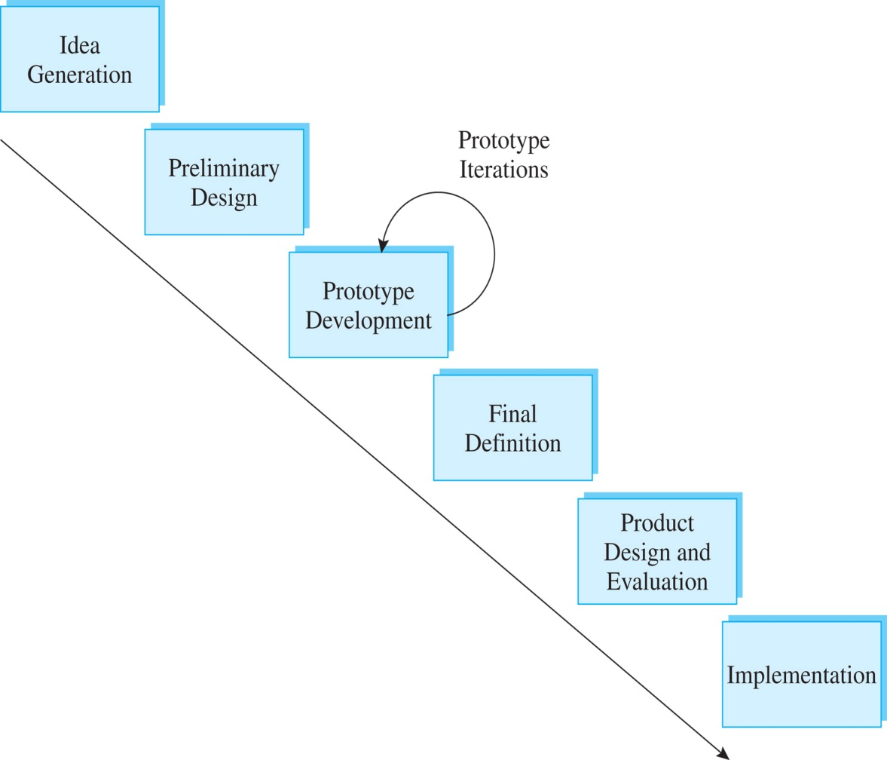
What is Quality? Differing Functional Perspectives on Quality
Engineering
Applying mathematical problem-solving skills
and modeling techniques
Product Design
Process Design
Design Life cycle

Slide 28
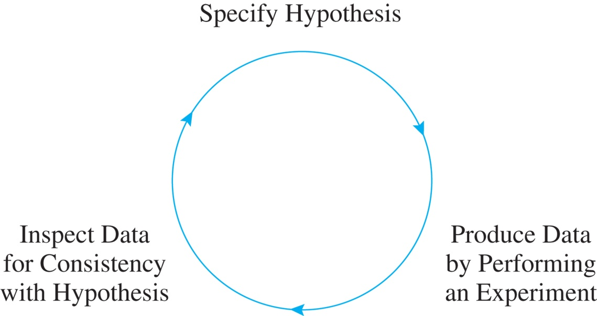
What is Quality? Differing Functional Perspectives on Quality
Operations Management
Statistical Process
Control (SPC)
Shewhart’s Control Process

Slide 29
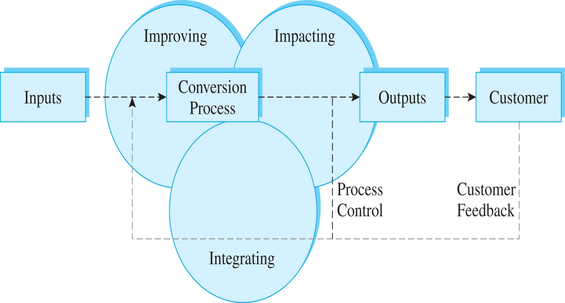
What is Quality? Differing Functional Perspectives on Quality
Operations
Management
Uses the
systems view that underlies modern quality management thinking
Conversion System Model of Operations Management

Slide 30
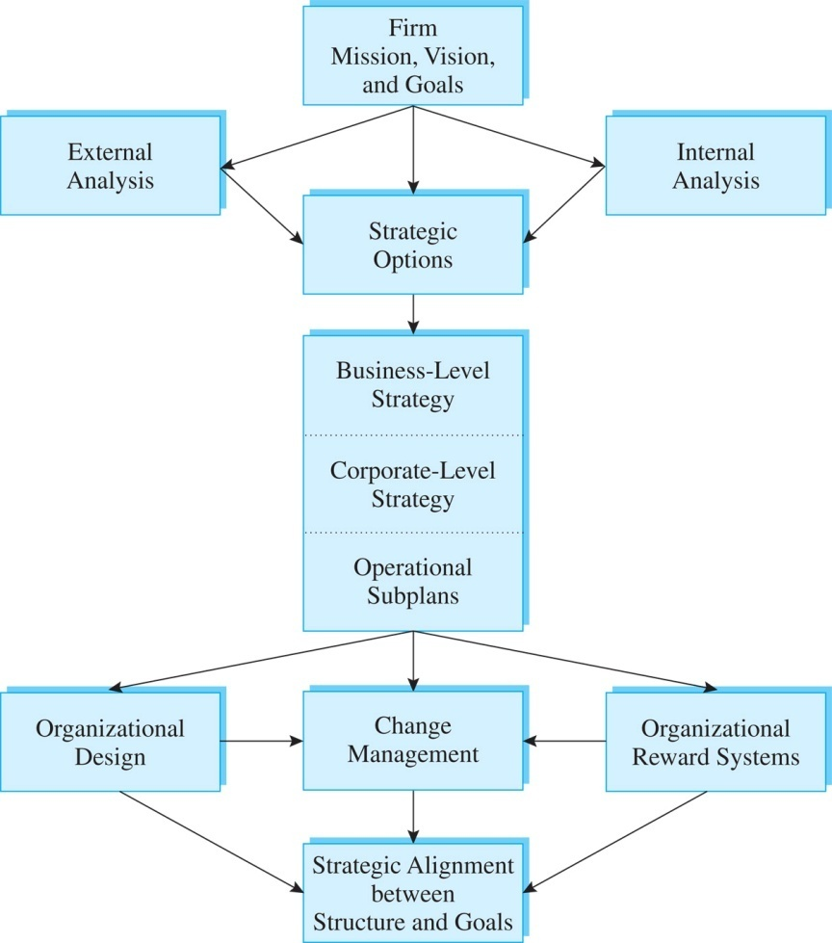
What is Quality? Differing Functional Perspectives on Quality
Strategic Management
Firms establish a planned course of action to achieve quality objectives
Course of action must be cohesive and coherent in terms of goals, policies, plans, and sequencing to achieve quality improvement
Aids an organization to achieve a sustainable competitive advantage
Generic strategic Planning Process

Slide 31
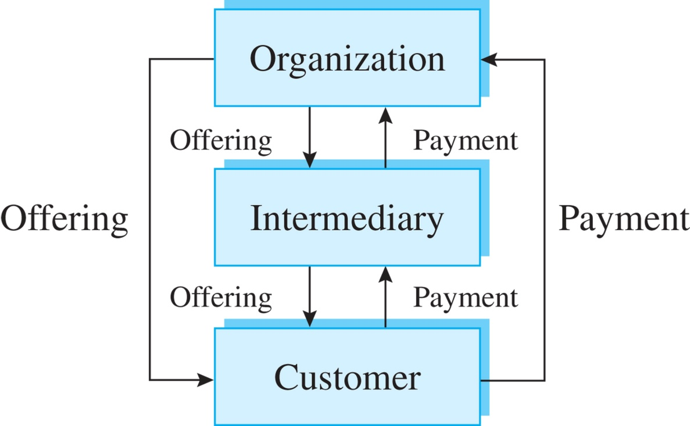
What is Quality? Differing Functional Perspectives on Quality
Marketing
Focuses on perceived quality of goods and services
The primary marketing tools for influencing customers perception of quality are price and advertising
The customer is the focus of marketing-related quality improvement
Marketing System

Slide 32
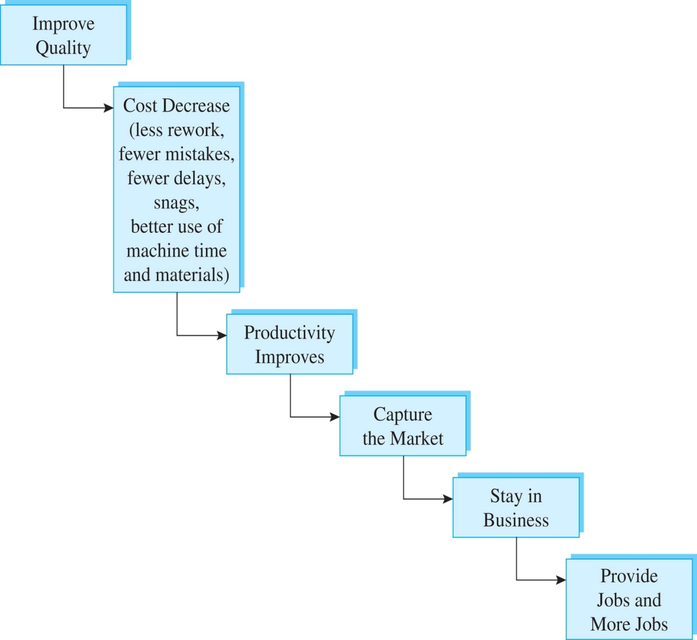
What is Quality? Differing Functional Perspectives on Quality
Financial
Relies more on quantified, measurable, results-oriented thinking
Identify and measure costs of quality by conducting trade-off and break-even analysis
The pursuit of quality does not safeguard a company against bad management
Deming Value Chain

Slide 33
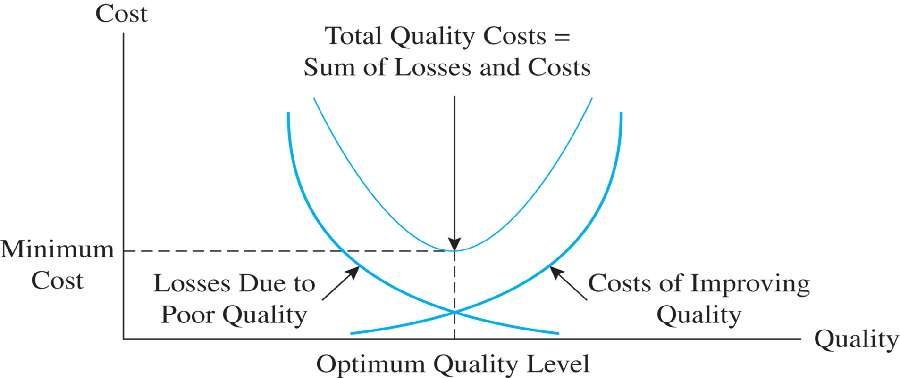
What is Quality? Differing Functional Perspectives on Quality
Financial
Law of diminishing returns

Slide 34
What is Quality? Differing Functional Perspectives on Quality
Human Resources
Employee empowerment
Organizational design
Job analysis
Quality management flourishes where the workers’ and company’s needs are closely aligned

Slide 35
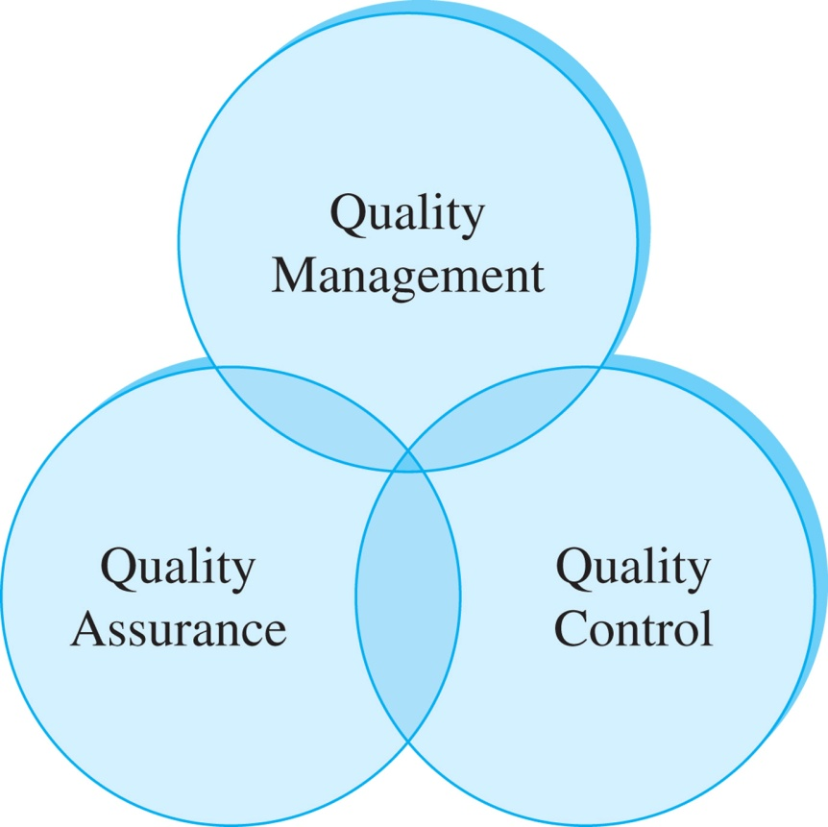
What is Quality?
What is Quality?
The Three Spheres of Quality

Slide 36
What is Quality?
`
Other Perspectives on Quality:
Value-Added Perspective on Quality
Cultural Perspective on Quality

Slide 37
What is Quality? Chapter 1 Review
`
There are different perspectives on quality
There is disagreement on the definition of quality
Functional perspectives on quality vary greatly
Quality control, quality assurance and quality management focus on different aspects of quality
Quality improvement requires a complex mix of system design, organizational design, rewards design, and process design

Slide 38
`
All rights reserved. No part of this publication may be reproduced, stored in a retrieval system, or transmitted, in any form or by any means, electronic, mechanical, photocopying, recording, or otherwise, without the prior written permission of the publisher.
Printed in the United States of America.
All rights reserved. No part of this publication may be reproduced, stored in a retrieval system, or transmitted, in any form or by any means, electronic, mechanical, photocopying, recording, or otherwise, without the prior written permission of the publisher.
Printed in the United States of America.
All rights reserved. No part of this publication may be reproduced, stored in a retrieval system, or transmitted, in any form or by any means, electronic, mechanical, photocopying, recording, or otherwise, without the prior written permission of the publisher.
Printed in the United States of America.

